Slide 1



Relational vs. Non-Relational Databases
Relational and non-relational databases are two distinct types of database management systems, each with unique strengths and weaknesses. Understanding these differences is crucial when choosing the right database for your application.
by Nsisong Akpaikpe

Slide 2
Differences Between Relational and Non-Relational Databases
Relational Databases
Non-Relational Databases
Data is structured in tables with rows and columns, following a predefined schema.
Data can be stored in various formats, like key-value pairs, documents, or graphs.
Data relationships are defined through keys and foreign keys, enforcing data integrity.
Data is flexible and doesn't need to adhere to a rigid schema, accommodating complex data types.
Examples: MySQL, PostgreSQL, Oracle Database
Examples: MongoDB, Cassandra, Redis

Slide 3

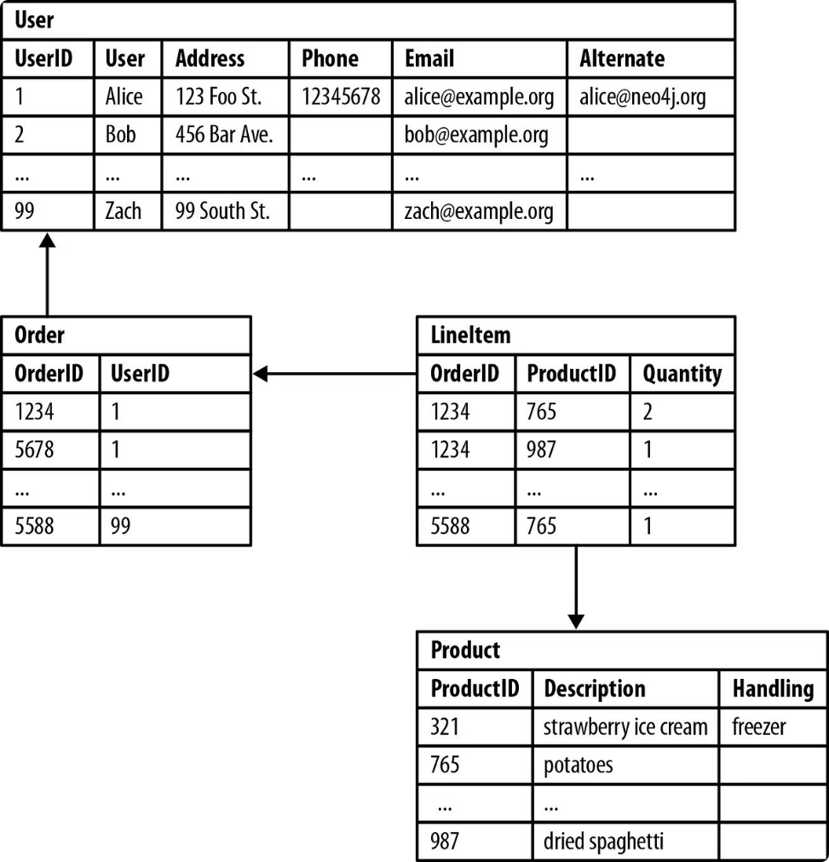
Characteristics of Relational Databases
1
Structured Data
2
Data Integrity
Relational databases excel at storing and managing structured data that fits neatly into predefined tables with rows and columns.
The rigid schema and relationships enforced by keys ensure data consistency and accuracy.
3
ACID Properties
4
SQL Queries
Relational databases typically adhere to ACID properties (Atomicity, Consistency, Isolation, Durability) to ensure reliable transactions.
Structured Query Language (SQL) provides a standardized and powerful way to interact with relational databases, querying and manipulating data.

Slide 4

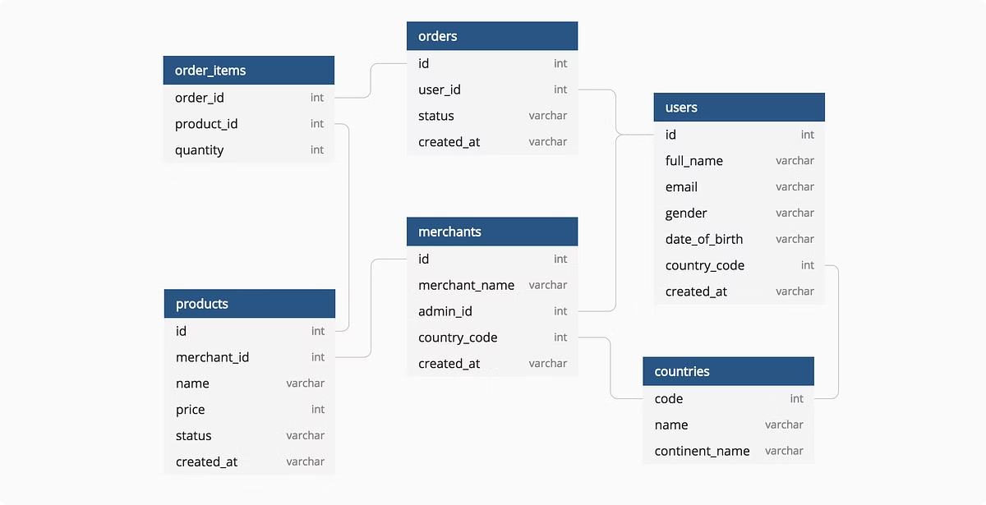
Characteristics of Non-Relational Databases
Flexible Data Models
Scalability
Non-relational databases allow for diverse data formats, supporting unstructured and semi-structured data.
Non-relational databases are often designed for scalability, handling massive datasets and high-volume data ingestion.
High Availability
Performance Optimization
Many non-relational databases offer high availability features, ensuring data accessibility even during failures.
Non-relational databases often prioritize performance, particularly for read-heavy workloads and real-time applications.

Slide 5


Use Cases for Relational Databases
Financial Transactions
E-commerce
Inventory Management
Customer Relationship Management (CRM)
Human Resources Management
Data Warehousing

Slide 6





Use Cases for Non-Relational Databases
Social Media
Non-relational databases are well-suited for handling the dynamic and unstructured data found in social media applications.
Real-Time Analytics
They provide fast data processing and analysis, enabling real-time insights for applications like fraud detection and recommendation systems.
Content Management
Non-relational databases are ideal for managing large volumes of content, such as video streaming platforms and online libraries.

Slide 7






Advantages of Relational Databases
Data Integrity
Data Analysis
The structured schema and relationships enforce data consistency and accuracy, reducing errors and ensuring reliability.
SQL provides powerful querying capabilities, enabling complex data analysis and reporting.
Transaction Security
Mature Technology
ACID properties ensure that transactions are atomic, consistent, isolated, and durable, safeguarding data integrity and preventing data loss.
Relational databases have a long history and a mature ecosystem, with extensive tools and support available.

Slide 8






Advantages of Non-Relational Databases
Scalability
Performance
Non-relational databases are designed for scalability, handling large volumes of data and high traffic loads.
They prioritize performance, particularly for read-heavy workloads and real-time applications.
Flexibility
Cost-Effective
Non-relational databases accommodate diverse data formats, supporting unstructured and semi-structured data, making them suitable for modern applications.
They often have lower hardware and maintenance costs compared to relational databases.

